Slide 1
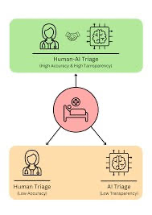
AI-Powered Triage System: Revolutionizing Urgent CarE
Coding by: Will Mikel
Attributions To: YUJI1702

Slide 2
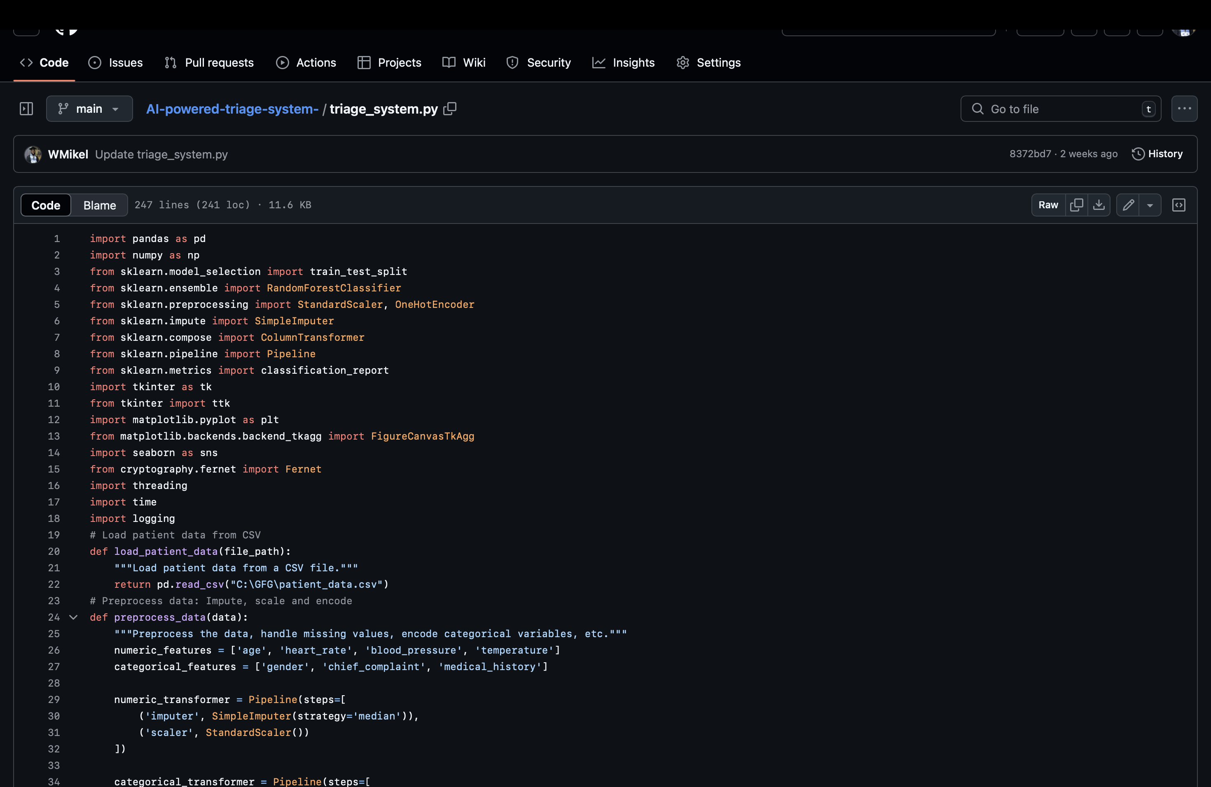
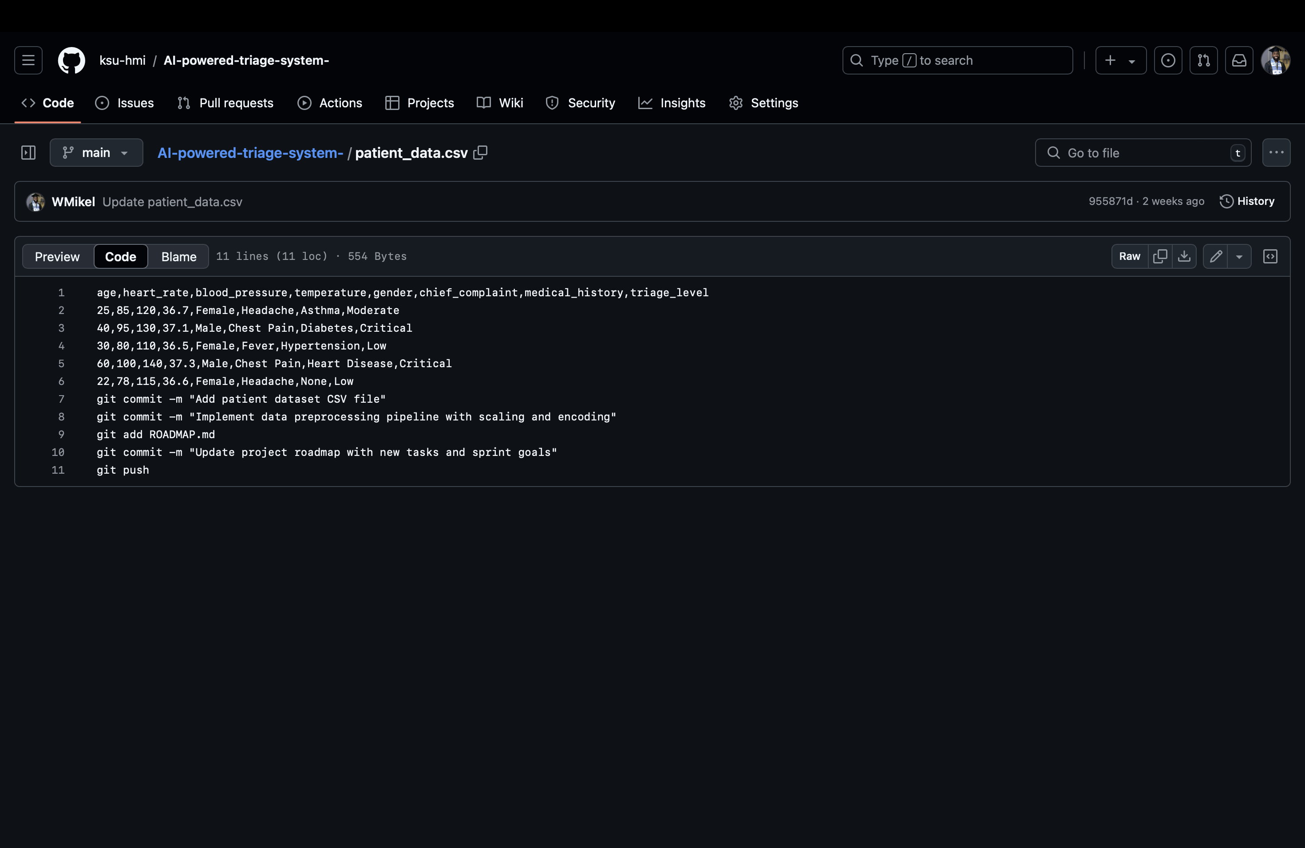
AI-Powered Triage System: Prioritizing Patient Care, Saving Lives
Problem: Delays in prioritizing critical patients lead to poor outcomes.
Solution: An AI system that automates patient prioritization.
How It Works: Visualize data flow and key features.
Impact: Improved patient outcomes and efficient resource use.
Next Steps: Highlight future scalability.

